Slide 1
Any Infrastructure.
Any Application. Anywhere.

Slide 2
Agenda
Open Source features
Infrastructure as code
Separate plan and apply
Multi-provider support & Public module registry
Enterprise Pro features
Collaboration and Workspace management
Enterprise Premium features
Policy as code management
Infrastructure change and access management
Notes:
Product deck
-Introduction:
- X in a dynamic world
- One workflow to X
- Use Cases
- Venn diagram of market landscape by use case
Simplify the middle of the deck to follow the same structure as the Roadmap decks, which is a list of features by Category.
Open Source
Pro
Premium
- Simplify the end of the deck to just have the below slides:
- Feature Overview
- Pricing (I will update this too)

Slide 3
Packaging
OSS addresses technical complexity and Enterprise addresses organizational complexity
Organizational Complexity
Provisioning
Individuals use
OSS
Teams use
Pro
Organizations use
Premium

Slide 4
Principles Define the Terraform Architecture
Terraform Core workflow and Terraform Provider extensible architecture
INFRASTRUCTURE AS CODE
PROVISIONING WORKFLOW
EXTENSIBLE PROVIDER MODEL
Core
Provider
Notes:
—

Slide 5

Infrastructure as code
INFRASTRUCTURE AS CODE
file.tf
resource "google_compute_instance" "server" {
name = "server"
machine_type = "g1-small"
zone = "us-central1-a"
disk {
image = "ubuntu-1404-trusty-v20160114e"
}
}
resource "dnsimple_record" "hello" {
domain = "example.com"
name = "server"
}
OPERATOR
Core
Provider
TERRAFORM CONFIGURATION
Notes:
The operator is responsible for provisioning infrastructure
Terraform provides a common and human-readable, machine executable language, HashiCorp Configuration Language (or HCL) that can be used to describe any infrastructure resource (private cloud, public cloud, services).
Terraform Configurations are declarative (and so are IaC tools such at Puppet, CloudFormations, and SaltStack) and used as the source of truth for infrastructure at any time. Compared to some orchestration ‘infrastructure as code’ tools that are imperative (such as Chef and Ansible) and focused on how to provision rather than what to provision. Overtime updating infrastructure using the imperative model means the infrastructure as code may not be the source of truth for infrastructure is actually provisioned. Limiting how well it can be used for lifecycle management.
When updating a TF configuration, say we want to change count to 5 GCP instances, we would change the value to 5, issue a plan and apply, and 4 additional instances would be provisioned. In an imperative IaC model, the code would be updated to 4 to provision 4 additional instance (and a total of 5). However if the operator wanted to see the state of infrastructure, the code would only reflect 5 instances rather than the 5 that truly exist.
An operator can checking the codified infrastructure and use version control to create, update, review infra

Slide 6
Infrastructure as code
resource "google_compute_instance" "server" {
name = "server"
machine_type = "g1-small"
zone = "us-central1-a"
disk {
image = "ubuntu-1404-trusty-v20160114e"
}
}
resource "dnsimple_record" "hello" {
domain = "example.com"
name = "server"
value = "${google_compute_instance.server.network_interface.0.address}"
type = "A"
}
Example

Slide 7
Infrastructure as code
resource "google_compute_instance" "server" {
name = "server"
machine_type = "g1-small"
zone = "us-central1-a"
disk {
image = "ubuntu-1404-trusty-v20160114e"
}
}
resource "dnsimple_record" "hello" {
domain = "example.com"
name = "server"
value = "${google_compute_instance.server.network_interface.0.address}"
type = "A"
}
Example

Slide 8
Infrastructure as code
resource "google_compute_instance" "server" {
name = "server"
machine_type = "g1-small"
zone = "us-central1-a"
disk {
image = "ubuntu-1404-trusty-v20160114e"
}
}
resource "dnsimple_record" "hello" {
domain = "example.com"
name = "server"
value = "${google_compute_instance.server.network_interface.0.address}"
type = "A"
}
Example

Slide 9

Infrastructure as code
Operators decompose infrastructure into modules for reuse
INFRASTRUCTURE AS CODE
module
module "mycompute" {
source = "Azure/compute/azurerm"
resource_group_name = "mycompute"
…
vnet_subnet_id = "${module.network.vnet_subnets[0]}"
}
module "network" {
…
}
…
OPERATOR
Core
Azure
Module Producer
compute
TERRAFORM CONFIGURATION
network
Notes:
the operator will tend to be both an expert in Terraform and the infrastructure.
using HCL they codify the resource and the necessary dependencies to provision the resource

Slide 10
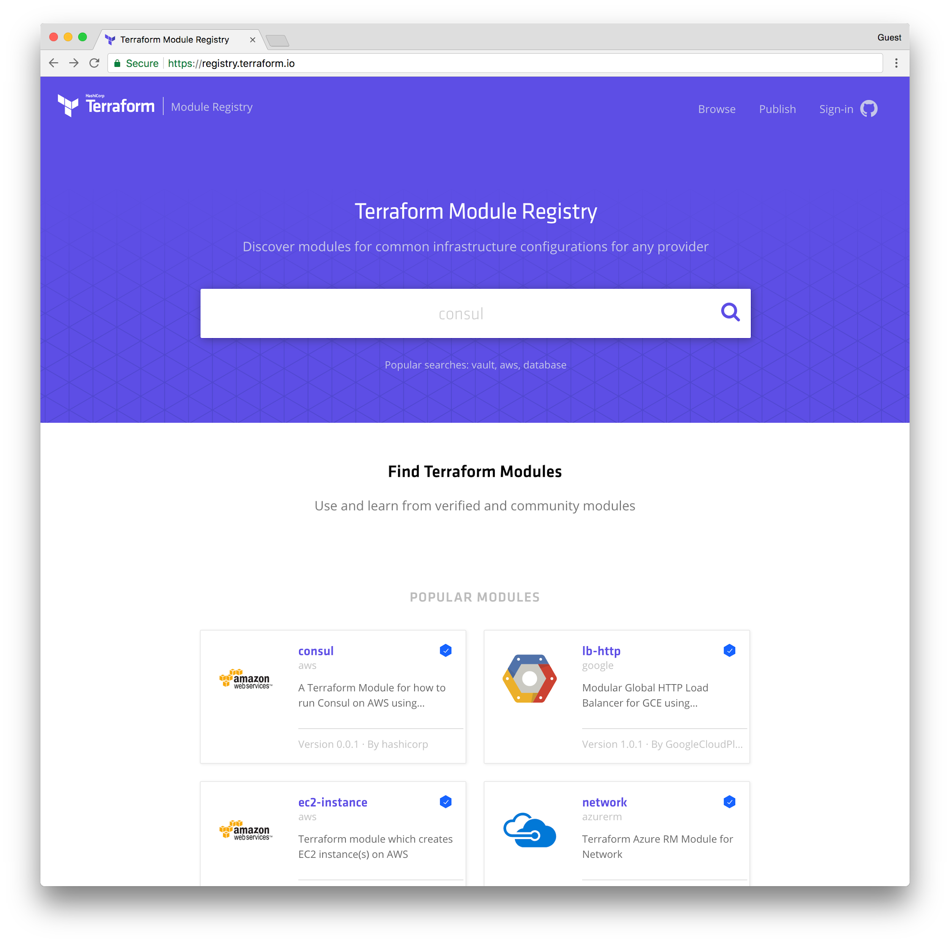
Terraform Module Registry
HashiCorp provides the public and freely available UI at registry.terraform.io
INFRASTRUCTURE AS CODE
OPERATOR
Core
Azure
Module Producer
compute
TERRAFORM CONFIGURATION
network
Notes:
An operator can use the publicly available Module registry, available at registry.terraform.io to publish modules.
Module producers include contributors from cloud partners like Microsoft, GCP, Alibaba), community members, and other partners.
Pre-created modules from cloud, community, partners
100+ modules available across cloud and service providers
Verified modules and community modules
Modules have version numbers to show iterate differences.

Slide 11
Terraform Module Registry
HashiCorp provides the public and freely available UI at registry.terraform.io
INFRASTRUCTURE AS CODE
Module Consumer
Core
Azure
Core
compute
Azure
Core
Azure
compute
compute
OPERATOR
Core
Azure
Module Producer
compute
TERRAFORM CONFIGURATION
network
Notes:
An operator can use the publicly available Module registry, available at registry.terraform.io to publish modules.
Module producers include contributors from cloud partners like Microsoft, GCP, Alibaba), community members, and other partners.
Pre-created modules from cloud, community, partners
100+ modules available across cloud and service providers
Verified modules and community modules
Modules have version numbers to show iterate differences.

Slide 12
Terraform Workflow
Use the Terraform plan to see what
PROVISIONING WORKFLOW
terminal
$ terraform plan
+ google_compute_instance.server
can_ip_forward: "false"
…
Plan
OPERATOR
Core
Provider
TERRAFORM CONFIGURATION
Notes:
The operator submits the Terraform configuration with a Terraform plan. This shows what Terraform will do (create, update, delete) resources.
The execution plan determines what actions are necessary to achieve the desired state specified in the configuration files.
The plan is saved and then used during the execution phase.
The plan phase uses state files to compare existing state with desired state. In Terraform open source, these state files are stored locally or can be shared by storing them in remote state storage such as like S3 for simple storage or Terraform Enterprise for enhanced storage (which is discussed in the Pro section).
Sharing and using state locking prevents creating inconsistencies in the state in cases where multiple users are running terraform plans or applies on the configuration.

Slide 13
Terraform Workflow
Safely and consistent provision and manage infrastructure
PROVISIONING WORKFLOW
terminal
$ terraform plan
+ google_compute_instance.server
can_ip_forward: "false"
…
Plan
OPERATOR
Core
Provider
TERRAFORM CONFIGURATION
Notes:
The operator submits the Terraform configuration with a Terraform plan. This shows what Terraform will do (create, update, delete) resources.
The operator can then do a Terraform apply to execute that plan.

Slide 14
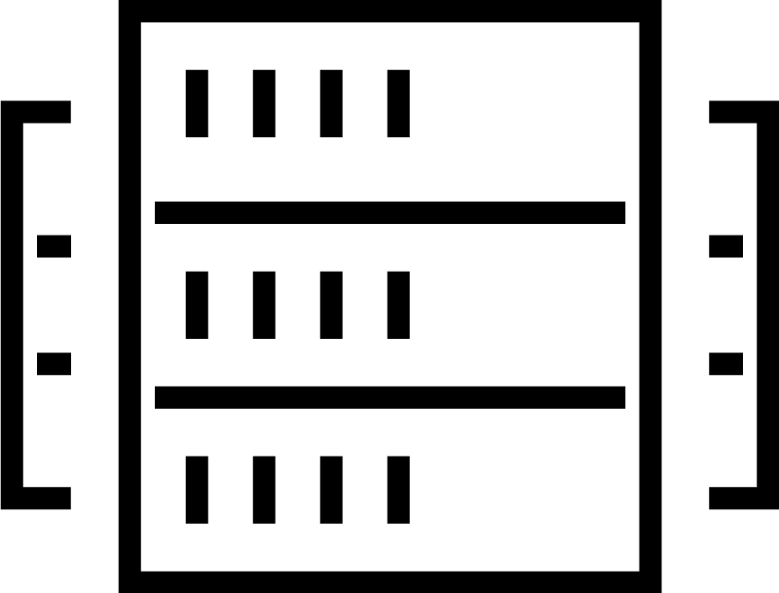
Terraform Workflow
PROVISIONING WORKFLOW
terminal
$ terraform apply
…
OPERATOR
Core
Provider
TERRAFORM CONFIGURATION
Apply
Notes:
The operator submits the Terraform configuration with a Terraform plan. This shows what Terraform will do (create, update, delete) resources.
The operator can then do a Terraform apply to execute that plan. These are two separates steps to ensure the operator knows exactly what resources will be created, updated, or deleted.

Slide 15
Extensible Provider Model
Provision infrastructure (IaaS, PaaS, SaaS) from cloud and service provider
EXTENSIBLE PROVIDER MODEL
DNSimple
GCP
OPERATOR
Core
Provider
API INTEGRATION (CRUD)
Notes:
Terraform Providers is an extensible architecture that uses a CRUD API to call the API to manage the resource— create, read, update, delete.
In this case, Terraform is using the Terraform GCP providers to provision an compute instance on GCP and the Terraform DNSimple provider to provision a DNS record.

Slide 16
Extensible Provider Model
Provision infrastructure (IaaS, PaaS, SaaS) from cloud and service provider
EXTENSIBLE PROVIDER MODEL
DNSimple
GCP
OPERATOR
Core
AWS
Notes:
Terraform Providers is an extensible architecture that uses a CRUD API to call the API to manage the resource— create, read, update, delete.
In this case, Terraform is using the Terraform GCP providers to provision an compute instance on GCP and the Terraform DNSimple provider to provision a DNS record.

Slide 17
Extensible Provider Model
Terraform includes over 70+ providers, 1000+ resources, always more
EXTENSIBLE PROVIDER MODEL
Fastly
GitHub
…
Kubernetes
Heroku
…
Datadog
Akamai
…
DNSimple
F5
…
GCP
OPERATOR
Core
AWS
Azure
Alibaba
Notes:
This architecture is extensible growing drastically over the year
There are now 70+ providers including IaaS, PaaS, SaaS providers which span both core cloud providers and external service providers
The providers include 1000+ resources (compute, DNS, etc.)

Slide 18
Providers for cloud, services, tools, and more
Major Cloud
AWS
Microsoft Azure
GCP
Alibaba
Oracle Public Cloud
Vsphere (major)
Infrastructure Software
Chef
Docker
Ignition
Kubernetes
OpenStack
RabbitMQ
Rancher
SpotInst
Rundeck
Mailgun
Monitoring and System Management
Circonus
Datadog
Icinga2
Librato
Logentries
LogicMonitor
New Relic
OpsGenie
PagerDuty
StatusCake
Database
InfluxDB
MySQL
PostgresSQL
Cloud
Arukas Cloud
cloudscale.ch
CloudStack
Scaleway
1&1
OVH
ProfitBricks
Triton
Heroku
CenturyLink Cloud
Digital Ocean
SoftLayer
Packet
Fastly
Cloud Director
Community
HP Oneview
IBM Cloud
OpenDayLight
Misc.
Archive
Cobbler
External
Grafana
HTTP
Local
Random
Template
TLS
VCS
Bitbucket
GitHub
GitLab
Network
Cloudflare
DNS
DNSMadeEasy
DNSimple
Dyn
NS1
PowerDNS
UltraDNS

Slide 19



Terraform Open source
Infrastructure as code, Terraform workflow, any infrastructure
INFRASTRUCTURE AS CODE
PROVISIONING WORKFLOW
EXTENSIBLE PROVIDER MODEL
Fastly
GitHub
…
Kubernetes
Heroku
…
Datadog
Akamai
DEVELOPER
…
DNSimple
F5
…
GCP
OPERATOR
Core
Provider
AWS
Azure
Alibaba
Notes:
This architecture is extensible growing drastically over the year
There are now 70+ providers including IaaS, PaaS, SaaS providers which span both core cloud providers and external service providers
The providers include 1000+ resources (compute, DNS, etc.)

Slide 20
Terraform Enterprise Pro
Collaboration features to scale Terraform from an individual to a team
Organizational Complexity
Collaboration
Provisioning
Provisioning
Individuals use
OSS
Teams use
Pro
Organizations use
Premium
Notes:
Common Management
A configuration file provides a single view of resources from all providers.

Slide 21
Workspace Management
Enable a team of operators to safely create, change and update infrastructure.
TERRAFORM CORE
A unit of organizations for larger scale infrastructures
Workspaces can be organized into infrastructure type or phase of development
Allows operators focused on networking to codify the network resources separate from compute
INFRASTRUCTURE ARCHITECT
Core
Provider
OPERATOR
dev-network
dev-compute
dev-monitor

Slide 22
Version control connection
Connect to popular version control systems using the Terraform Enterprise UI

Slide 23
Terraform Enterprise Workspace Management
Enable a team of operator to safely create, change and update infrastructure.
TERRAFORM CORE + VERSION CONTROL
INFRASTRUCTURE ARCHITECT
Core
Provider
Github, Bitbucket, Gitlab
Notes:
- Not equivalent to "noop" due to the ability to save a plan
Integrates with popular version control systems Gitlab, Bitbucket, Github both Private and SaaS offerings

Slide 24
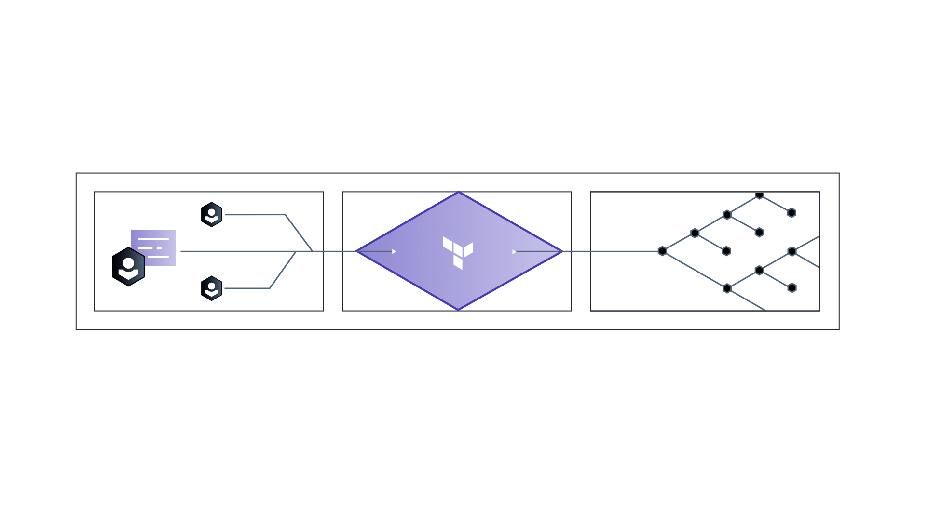
Version control connection
Version control allows a team of operators to treat Terraform files as source code and checkout and make changes to infrastructure
Capability | Benefit
Support for common version control systems (GitHub, GitLab, Bitbucket) | Safely collaborate on infrastructure
 | Eliminate conflicts on infrastructure changes
 | Improve operator productivity, no time coordinating changes

Slide 25
Version control connection
Source code repository for Terraform configurations
OAuth based authentication
Automatic plan execution when pull request is created or updated
Pull request is updated with result of the Terraform plan

Slide 26
Remote plans, applies, state storage, and locking

Slide 27
Remote plans, applies, state storage, and locking
Capability | Benefit
Terraform Plan: View history and output of the Terraform plan execution prior to pushing to production | Safely plan changes across a team
Terraform Apply: Make changes to production infrastructure | Safely apply changes to infrastructure across a team
View a detailed history of the infrastructure changes | Ability to audit changes easily compare states in diff view
Environment lock | Prevent state changes
Notes:
As usage of Terraform open source grows, users find they need more effective ways to manage Terraform state amongst their teams. Individuals could accidently corrupt one another's state if not locked correctly. TFE stores and manages this state per workspace. This ensures that all changes to state are through TFE, serialized, audited, policy checked, and plan/applied.
TFE also allows environment locking. Example: Retail customer during Christmas season. No changes should be made.

Slide 28
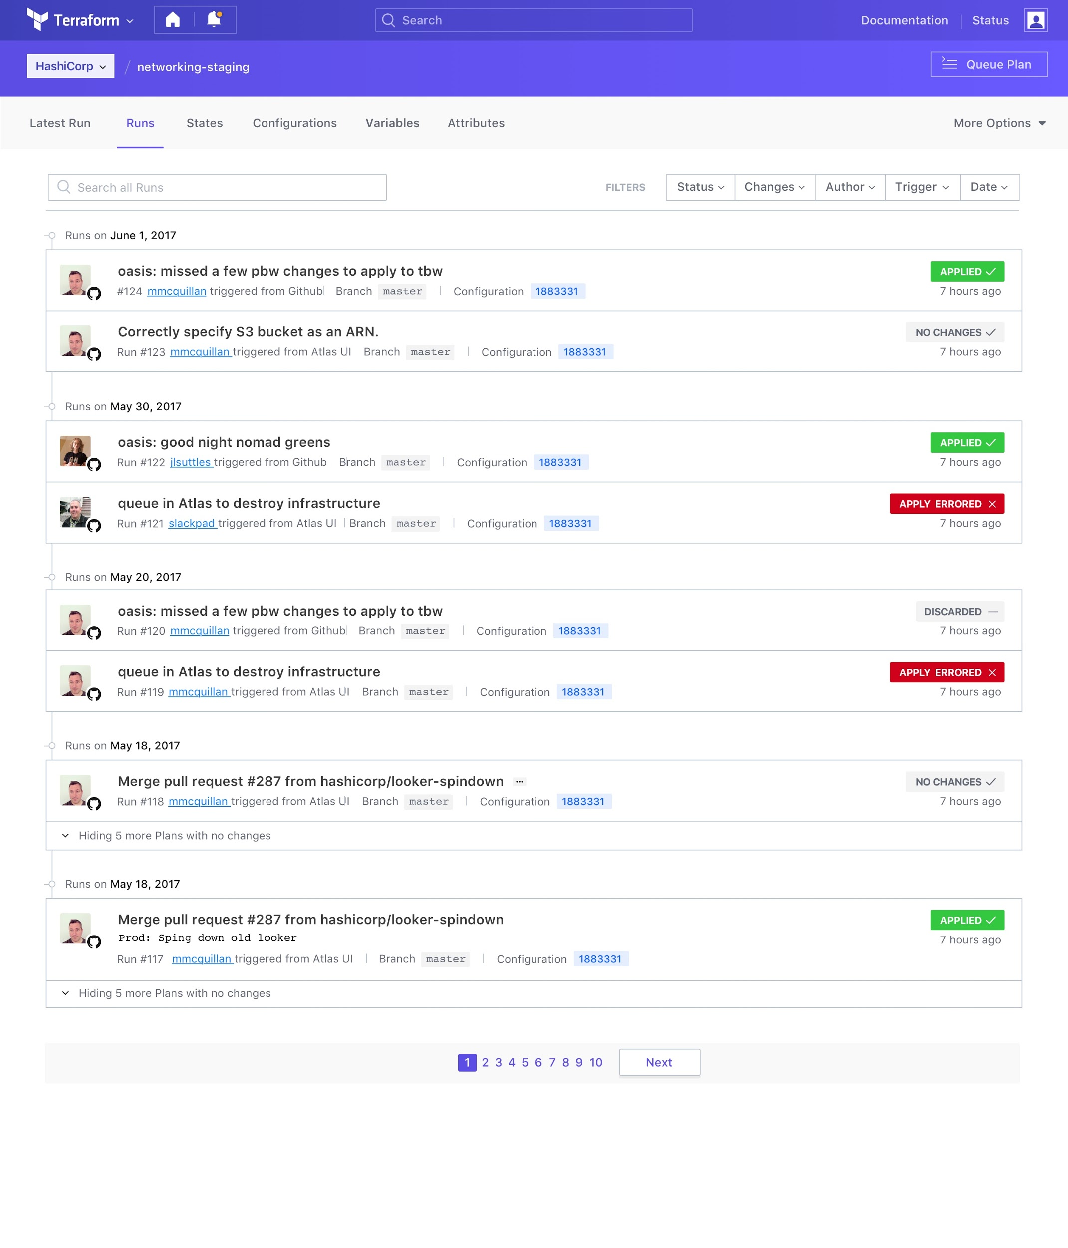
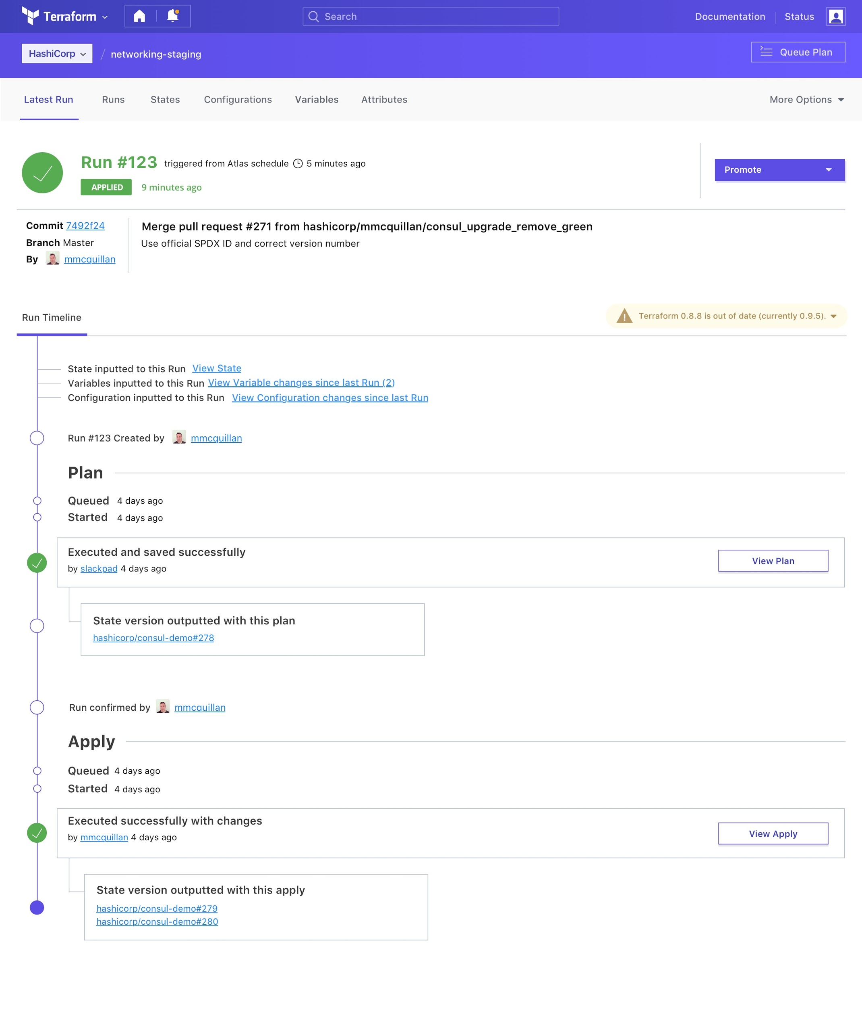
Workspace runs and state

Slide 29
Workspace alignment between OSS and Enterprise
Ability for operators to work with Terraform OSS and have it reflected in Enterprise

Slide 30
Comprehensive API Coverage
Ability interact with all parts of Terraform using the API

Slide 31
Comprehensive API coverage
Interface with all parts of Terraform using an API
Operators can easily integrate Terraform into existing workflow and minimize process changes
Environment variable changes
Trigger plan/apply executions
Retrieve state information

Slide 32
Module Registry
Integration of module registry in the Enterprise Workspace UI

Slide 33
Module registry integration
Make Terraform shareable for experts and consumable for beginners
Enables operators to create modules with costs, utilization, and exposure controls in-place
Enables developers to provision infrastructure without having to understand the details (Metaphor about a car: operators are the mechanics and developers are the drivers)

Slide 34
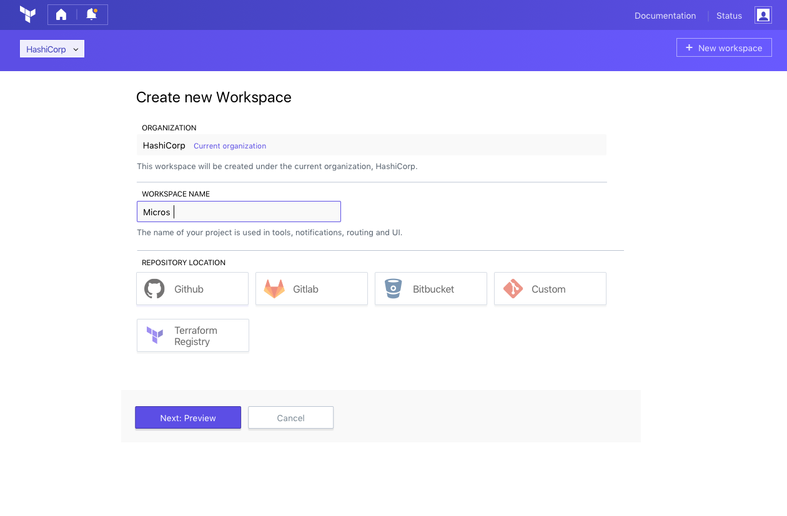
Create a new Workspace
Workflow based usage using Workspaces

Slide 35
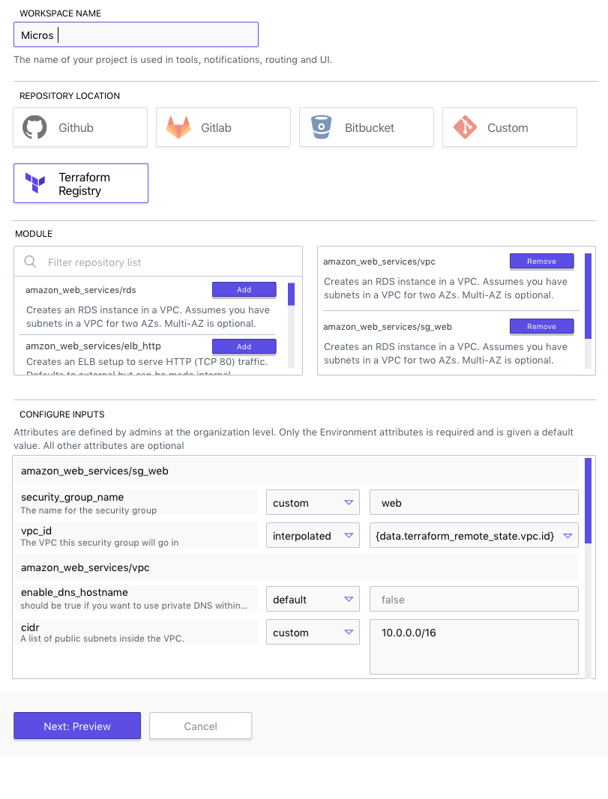
Select predefined modules to provision infrastructure
Select multiple modules for new Workspace

Slide 36
Define variables and create infrastructure
Set variables with customer values, interpolation or use default values

Slide 37
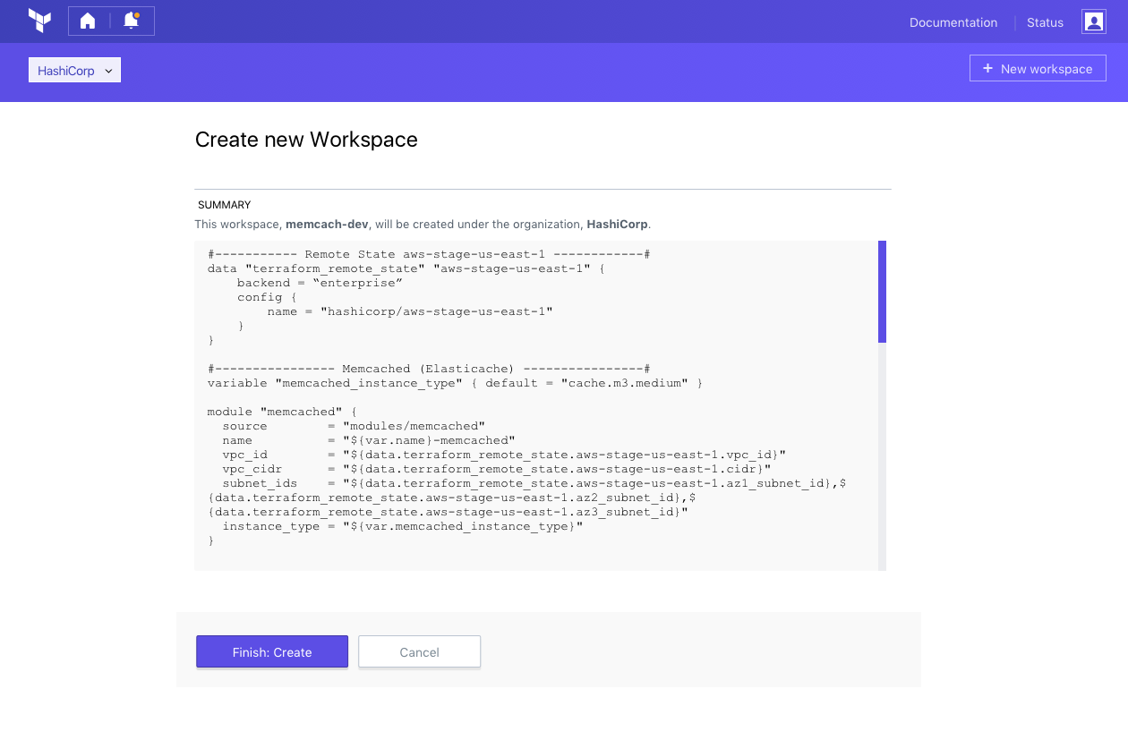
Workspace UI creates Terraform configuration
Read environment networking details from Remote State
Use those as details for Module inputs

Slide 38
Terraform Enterprise Premium
Governance features to scale Terraform from a team to an organization
Governance
Organizational Complexity
Collaboration
Collaboration
Provisioning
Provisioning
Provisioning
Individuals use
OSS
Teams use
Pro
Organizations use
Premium
Notes:
Common Management
A configuration file provides a single view of resources from all providers.

Slide 39
SAML Support
Single Sign-on via SAML

Slide 40
Why SAML?
Security Assertion Markup Language (SAML) is a standard protocol for web browser Single Sign-On (SSO) using secure tokens
SAML eliminates all passwords and instead uses standard cryptography and digital signatures to pass a secure sign-in token from an identity provider to Terraform Enterprise

Slide 41
SAML and TFE Teams
Terraform Enterprise will support receipt of a SAML assertion identifying an individual user
The SAML assertion will contain the list of Terraform Enterprise teams the user is a member of
Teams must exist in Terraform Enterprise before a user can be added to them
Team membership is updated at login to match (add and remove) those listed in the SAML assertion

Slide 42
Policy as code management
An embedded policy as code framework integrated with HashiCorp Enterprise products

Slide 43
Sentinel Policy as Code
An embedded policy as code framework
Sentinel enables fine-grained, logic-based policy decisions, and can be extended to use information from external sources
For Terraform Enterprise this means
Preventing provisioning mistakes or misuse
Ensuring provisioning meets with regulatory requirements
Enforcing company policy on all provisioning

Slide 44
Sentinel Example
Declare a list of allowed machine types for GCP
Iterate all resources in the Terraform plan (tfplan)
Return true if all machine types are in the allowed machine list
import "tfplan"
allowed_machine_types = [
"n1-standard-1",
"n1-standard-2",
"n1-standard-4",
"n1-standard-8",
]
main = rule {
all tfplan.resources as type, resources {
all resources as r {
r.applied.machine_type in allowed_machine_types
}
}
}

Slide 45
Sentinel Enforcement Modes
Enforcement Mode: This sets the level to which the policy is enforced when performing a run
hard-mandatory (cannot override): This policy is required on all terraform runs. It cannot be overridden by any users
soft-mandatory (can override): This policy is required. If a terraform plan fails to comply, it can be overridden by a member of the organization owners team
advisory (logging only): This policy will allow the run to continue to an apply in both pass and failures of the policy check

Slide 46
Sentinel Imports
Import the configuration, plan and/or state data for Sentinel to policy check
Configuration is all modules, resources, data sources and outputs declared in your tf files
Plan is the output from terraform plan giving access to variables and computed values that can be determined before a terraform apply
State is the current picture of the provisioned resources, before the next terraform run

Slide 47
Audit logging
Ability to see when and who made changes to infrastructure

Slide 48
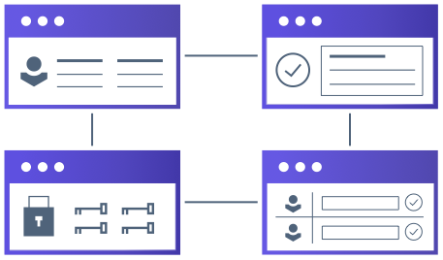
Audit log for change governance
Event logs track all operations made by operators across a team
Settings
Configuration changes
Executions
Environment updates

Slide 50
Use cases and the current landscape
Infrastructure as Code
Cloud Platform Management
Configuration Management & Orchestration tools
Hybrid cloud management products
Point & Click Management portals
Self-Serve infrastructure
Notes:
Points:
The current landscape of offerings has products that focus on one or two of the use cases.
Configuration management tools like Chef and Puppet or Orchestration tools like CloudFormations
Hybrid Cloud management products that provide cloud agnostic offerings to manage infrastructure across providers
Point & Click management portals that provide high-level operators/executives provisioning workflows
Provisioning infrastructure requires each of these use cases.
Infrastructure as code for automation, scale, iteration, and reuse
Hybrid cloud for flexibility to use the right infrastructure, resource, service necessary
Self-service infrastructure for developers to use throughout the lifecycle of application development (Operators are the mechanics that build the car and developers are the drivers)

Slide 51
Terraform is the preferred architecture
Open-Source Community
1,000+ Developers building resources and providers for all different infrastructure patterns.
Public Clouds are embracing Terraform as their provisioning engine: (e.g. Microsoft Commits to Terraform).
How quickly can you pivot off of a vendor and a vendor specific tool when the time comes.
Terraform Core enables true Infrastructure as code
Safely create, update, and apply changes to infrastructure
Full separation of plan and apply makes it much easier to identify the cause of issues before you execute changes
Dependency Graph means Terraform is more efficient in executing changes.
Terraform uses powerful primitives: Operators can write very clean code that can easily be reused with input variables, output variables, modules, etc.
Terraform templates: are easy to use, less verbose and HCL is easier to work with than JSON which is built for machines. JSON is supported to take advantage of existing work.
Terraform Providers enable ONE workflow for multi-cloud, multi-resource:
Select any infrastructure, a provider exists or can be written
Terraform can manage Cloud or any IaaS, PaaS, SaaS in the same template or module. Cloud-specific tools cannot manage non-Amazon services. Terraform has 80+ providers and growing.
Terraform Core, Provider split: Providers are open source and released separately from Core. New resources rapidly developed, often much faster than alternative closed source tools.
Terraform pluggable backend: Anything with an API can have a provider and be managed by Terraform. Providers can easily be built by partners and vendors.
Notes:
Community behind it: changes happen fast by the contributors that know the software and infrastructure the best.
Terraform Core figures out all of the intricacies of the infrastructure so the operators does not have too
Terraform Providers enable independent iteration on Terraform providers to enable that any infrastructure

Slide 52
Terraform Core and Providers
Terraform Core and Providers have separate binaries and can release independently
Community of 1,000+ contributors
Providers release frequently, separate from core functionality
The vastness of the community means fast updates to providers by those that know the infrastructure best

Slide 53
Resource Slides

Slide 54
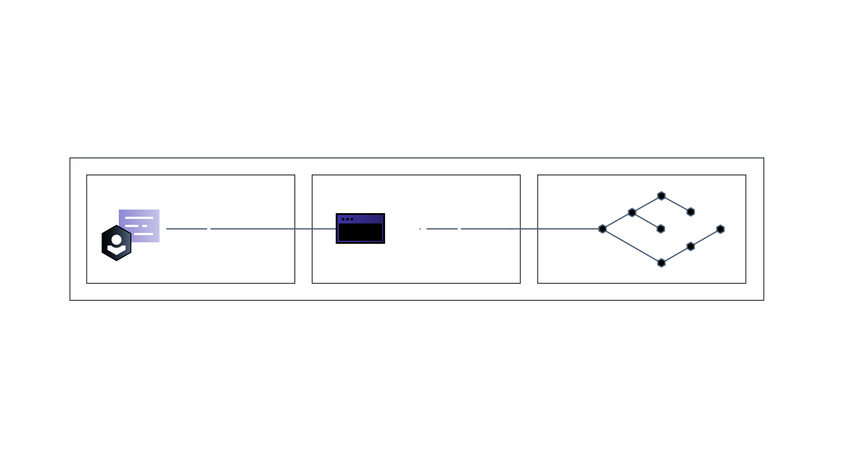
Consistent Workflow for individuals to provision any infrastructure
WRITE
on infrastructure as code using a version control system (VCS)
TEST
with separate plans
and apply
PROVISION
public cloud, private cloud,
and external services
Notes:
Common Management
A configuration file provides a single view of resources from all providers.

Slide 55
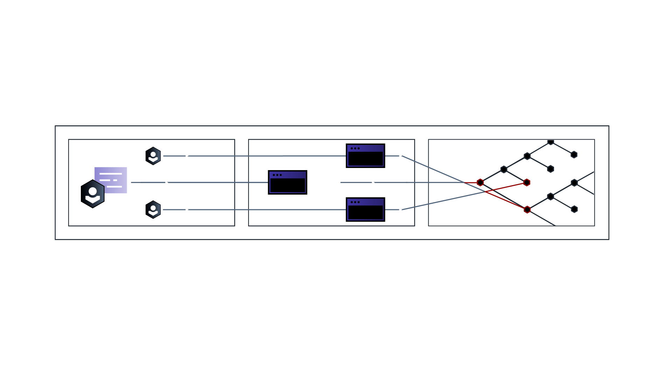
For teams, collaboration on codified infrastructure is challenging
WRITE
TEST
PROVISION
Notes:
Common Management
A configuration file provides a single view of resources from all providers.

Slide 56
Consistent Workflow
COLLABORATE
on infrastructure as code
using a version control system (VCS)
VALIDATE
with a common integrated
workflow for Plan & Apply
AUTOMATE
public cloud, private cloud,
and external services
Notes:
Common Management
A configuration file provides a single view of resources from all providers.

Slide 57
Consistent Workflow for teams
GOVERNANCE
COLLABORATE
on infrastructure as code
using a version control system (VCS)
VALIDATE
with a common integrated
workflow for Plan & Apply
AUTOMATE
public cloud, private cloud,
and external services
Notes:
Common Management
A configuration file provides a single view of resources from all providers.

Slide 58
Constant workflow
For provisioning in a hybrid, dynamic, and distributed world
COLLABORATE
on infrastructure as code
using a version control system (VCS)
VALIDATE
with a common integrated
workflow for Plan & Apply
AUTOMATE
public cloud, private cloud,
and external services

Slide 59
Customer commentary
Segment uses modules to help reduce infrastructure spend at AWS by $1million, increase utilization XX%, and reduce time to provision infrastructure from 3 weeks to 30 seconds.
PayPal to eliminate drift that would become a security vulnerability.

Slide 60
Competitive eye chart

Slide 61
Workspace runs and state
Repository (VCS)

Slide 62
What does it look like when you put it all together.
Image on the Consul product page.

Slide 63
Infrastructure as code
Operator codifies infrastructure in a Terraform configuration file
Capability | Benefit
High-level syntax to describe any infrastructure | Consistently workflow to provision infrastructure from multiple providers
 | Terraform configuration files provides a single view of infrastructure across providers
 | Reuse infrastructure as code to consistently provision infrastructure
Notes:
-

Slide 64
Separation of plan and apply
Operators safely create and update infrastructure
Capability | Benefit
Terraform plan allows an operators to see changes to infrastructure before they are applied | Safely make changes to infrastructure
Terraform reconciles dependencies between resources | Reduce manual coordination and human error
Terraform Apply provisions infrastructure (in parallel where there are not dependencies) | Provision infrastructure quickly
Notes:
The configuration is declarative and Terraform will automatically infer dependencies and uses this information to parallelize the creation of your infrastructure as much as possible. Execution plans show you what changes Terraform plans on making to your infrastructure. These plans can then be saved and applied, ensuring Terraform will only execute what is in the plan.
As a result, you know exactly what Terraform will do to your infrastructure to reach your desired state, and you can feel confident that Terraform won't surprise you in unexpected ways.
For example, after creating the example above, we can change the size of the DigitalOcean Droplet, and see what Terraform would do. The before the Droplet means that Terraform will update the resource in-place, instead of destroying or recreating.

Slide 65
Workspaces to manage infrastructure at scale
Ability to tag infrastructure modules with attributes and then search infrastructure modules

Slide 66
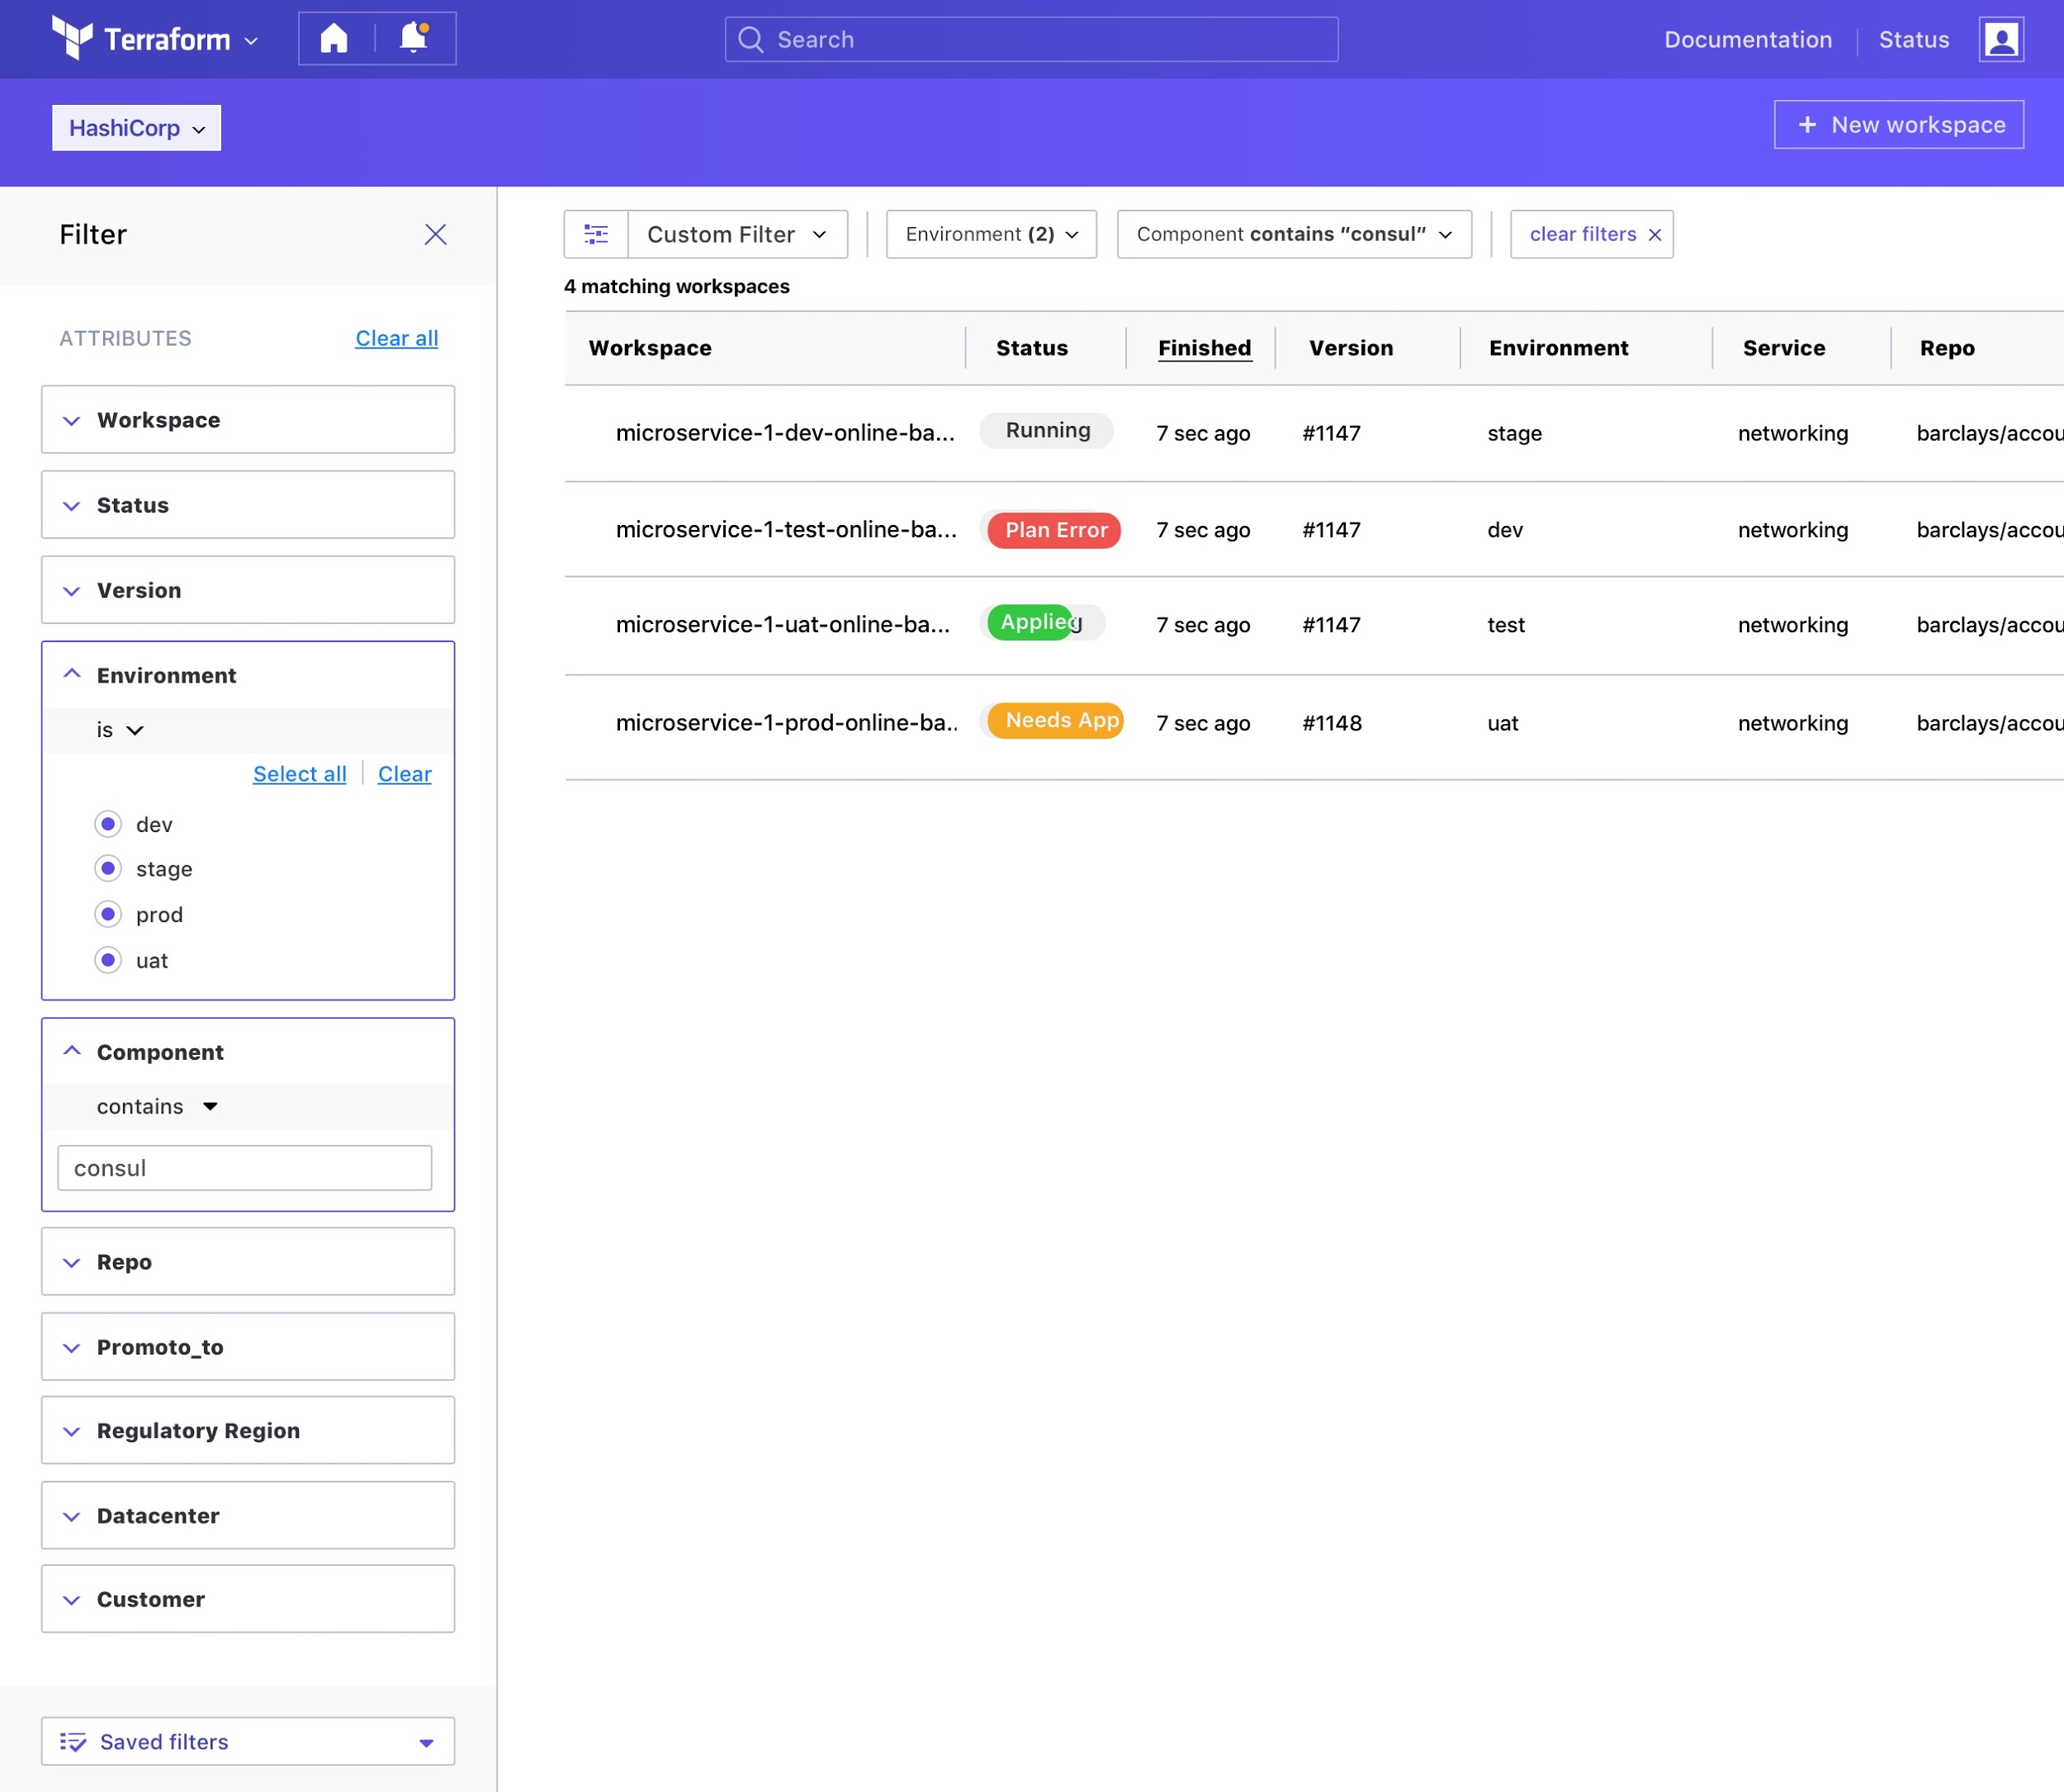
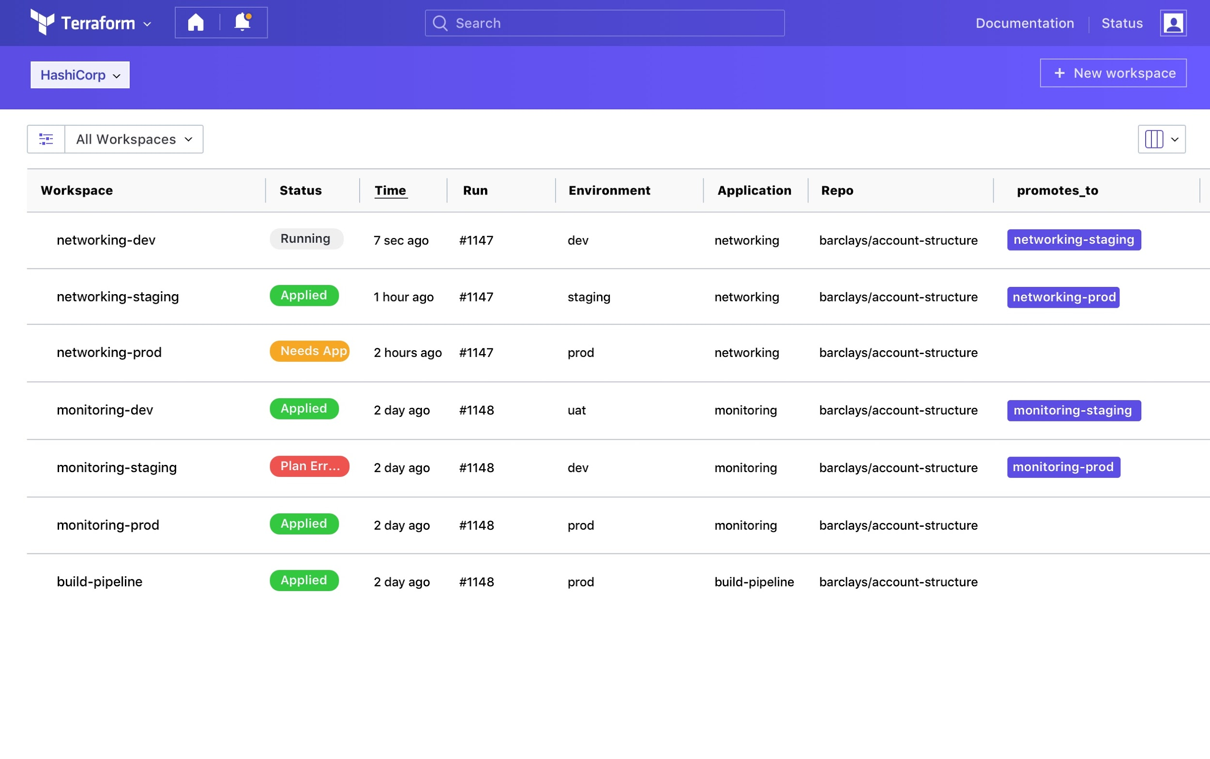
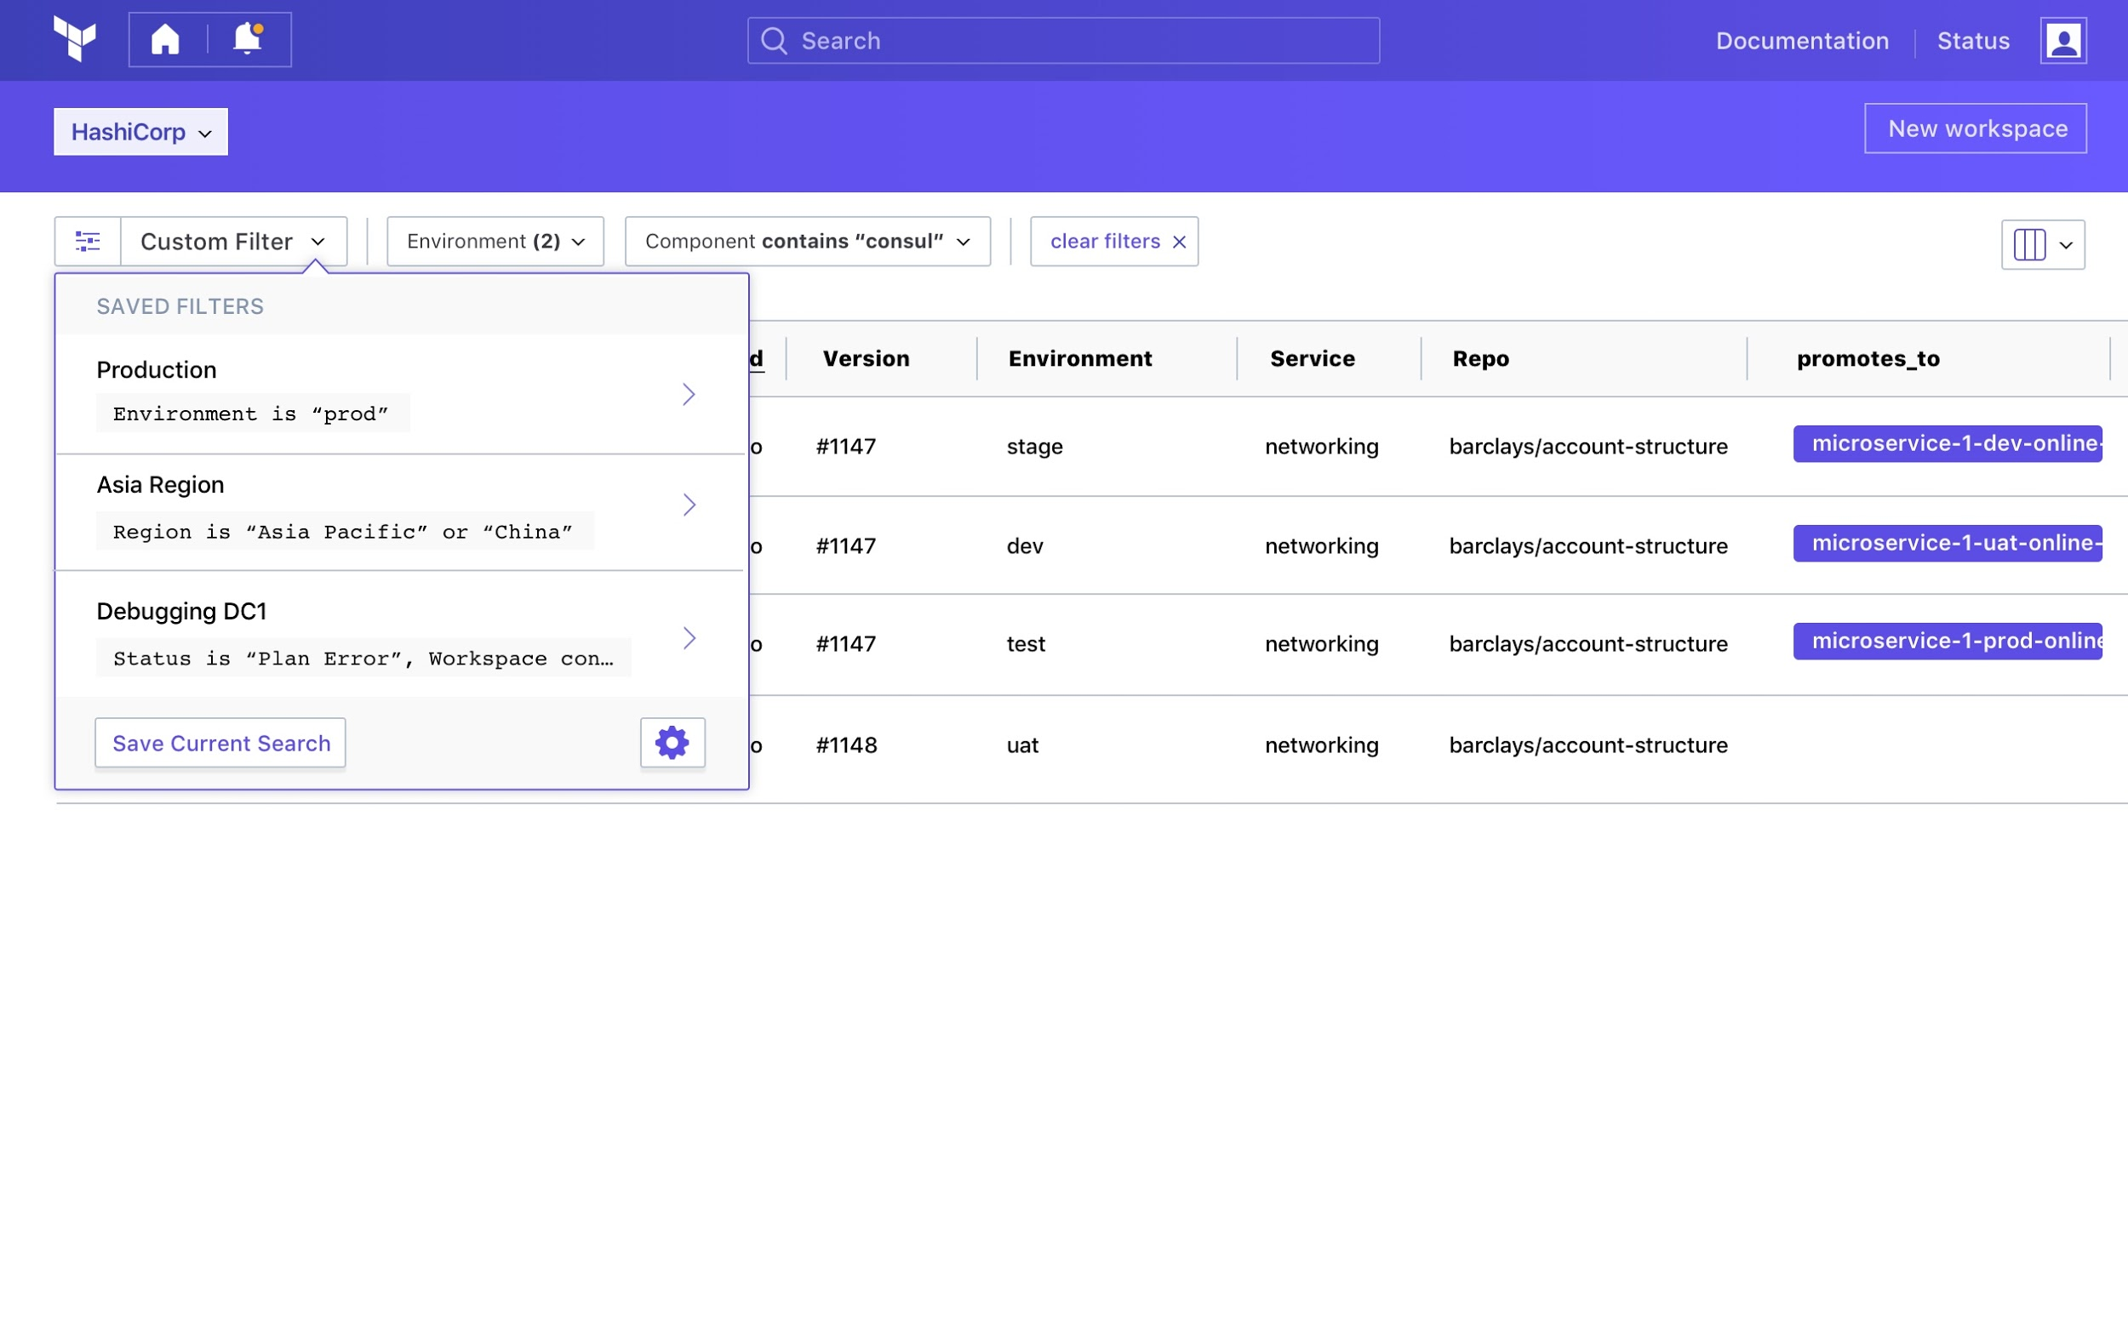
Workspace list & filter

Slide 67
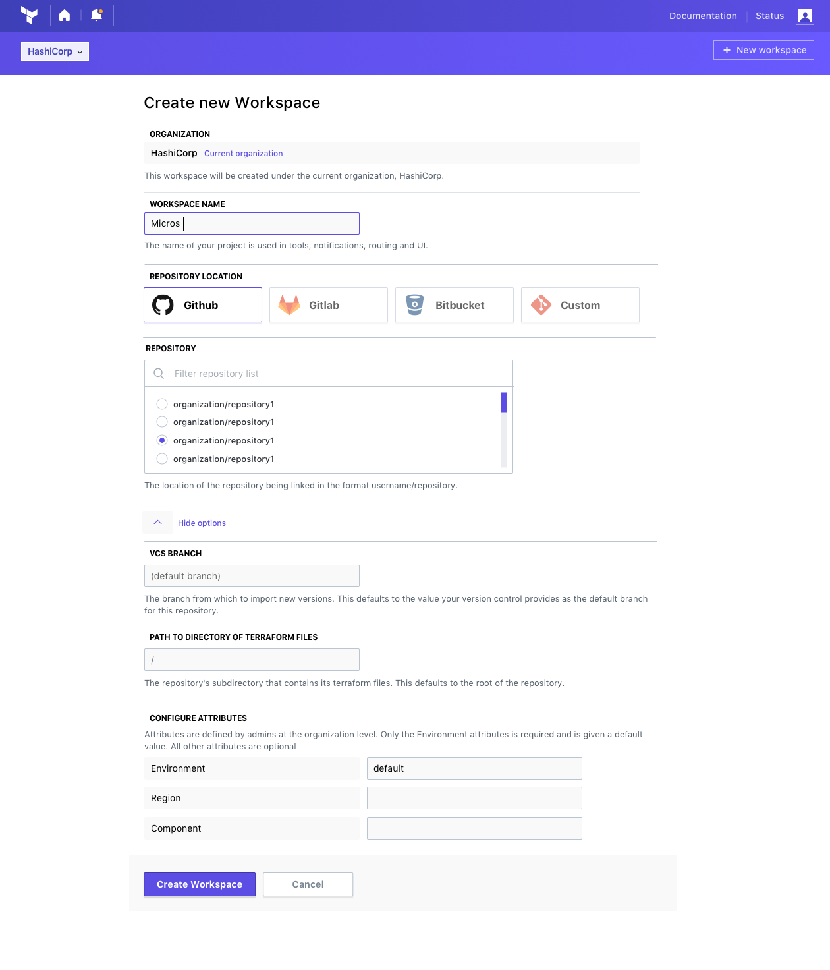
Workspace create

Slide 68
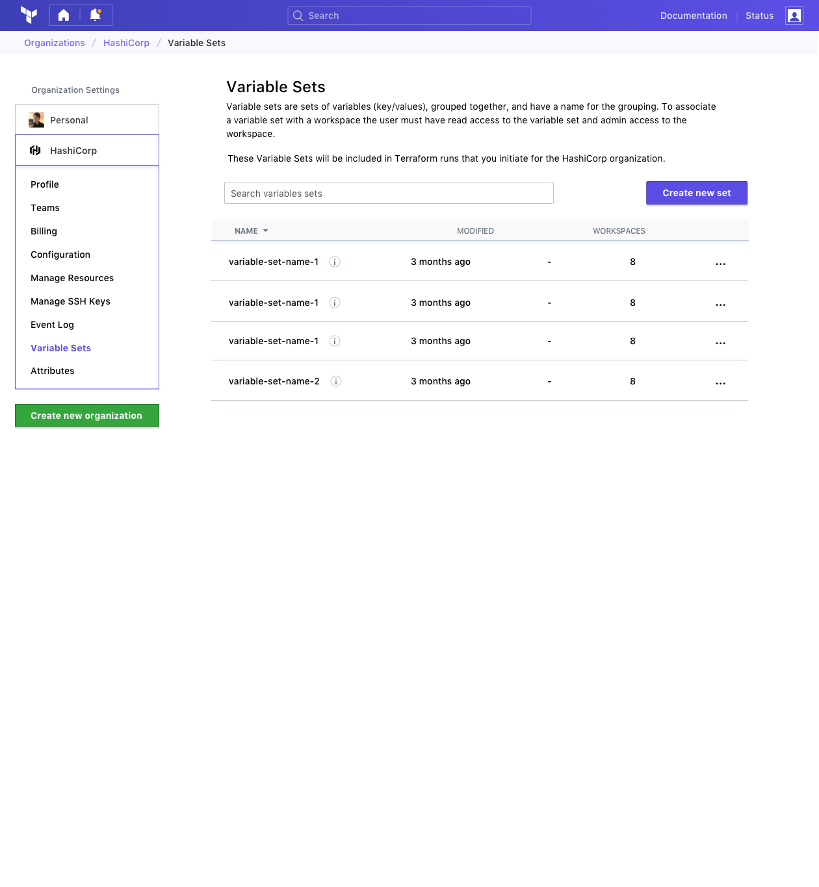
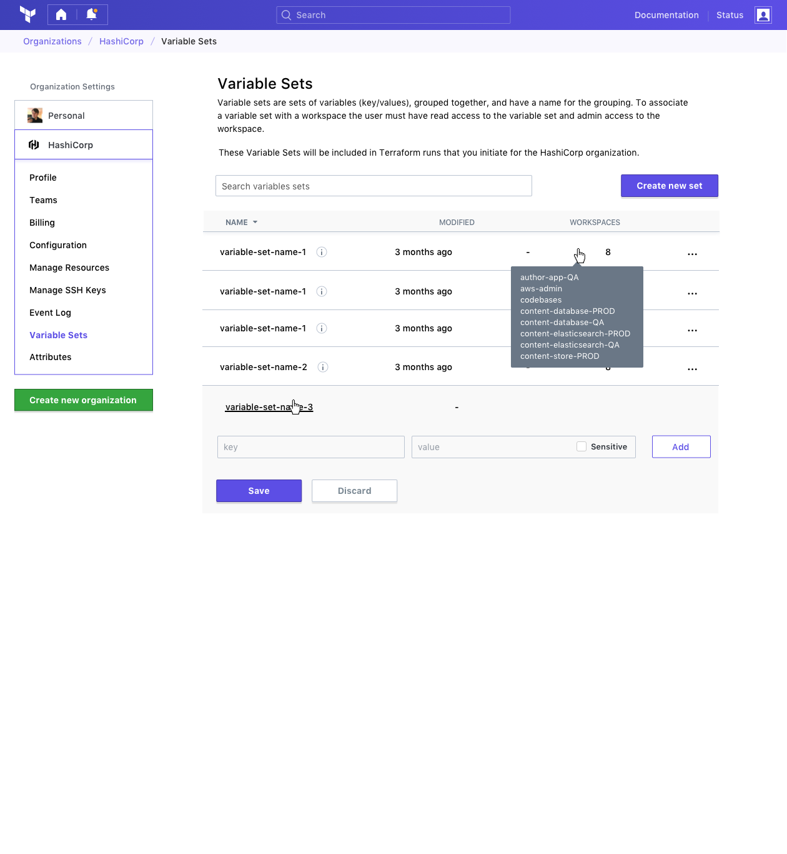
Secure variable management and variable sets
Share and manage access to Variables in your organization

Slide 69
A Terraform for each phase of the journey
Provisioning
Goals
Organizational
Complexity
HashiCorp
Terraform
A way to provision
any infrastructure
Open Source
A way for teams to collaborate on infrastructure
Enterprise Pro
A way for organizations to govern infrastructure
Enterprise Premium
Notes:
Common Management
A configuration file provides a single view of resources from all providers.

Slide 70
A Terraform for each phase of the journey
Provision any infrastructure
Collaborate on infrastructure
Governance over infrastructure
Open Source
Enterprise Pro
Enterprise Premium
Infrastructure as code
Cloud platform management
Self-service infrastructure
Notes:
Common Management
A configuration file provides a single view of resources from all providers.

